Slide 1
IP Subnetting – Zero to Hero Summary IP Address
CyberQuince

Slide 2
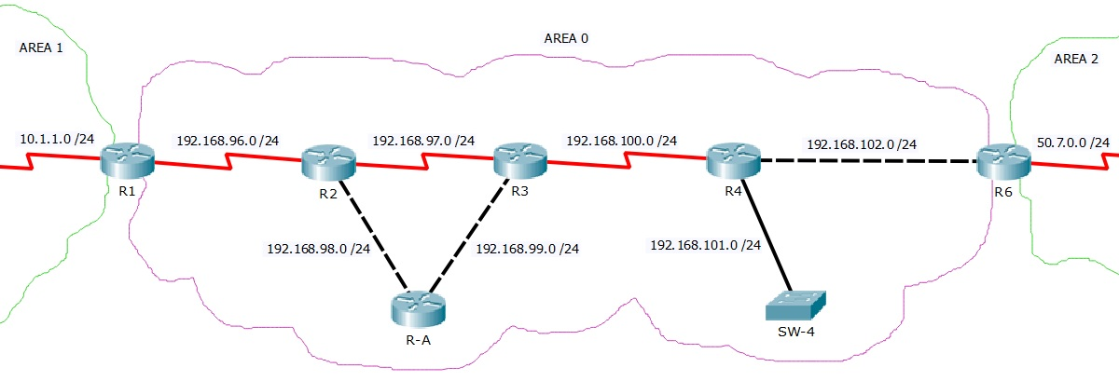
Summarization – Example
hhh

Slide 3
Summarization – Example
 | 128 | 64 | 32 | 16 | 8 | 4 | 2 | 1
192.168.

Slide 4
Summarization – Example
 | 128 | 64 | 32 | 16 | 8 | 4 | 2 | 1
192.168. (96)

Slide 5
Summarization – Example
 | 128 | 64 | 32 | 16 | 8 | 4 | 2 | 1
192.168. (96) | 0 | 1 | 1 | 0 | 0 | 0 | 0 | 0

Slide 6
Summarization – Example
 | 128 | 64 | 32 | 16 | 8 | 4 | 2 | 1
192.168. (96) | 0 | 1 | 1 | 0 | 0 | 0 | 0 | 0
192.168. (97)

Slide 7
Summarization – Example
 | 128 | 64 | 32 | 16 | 8 | 4 | 2 | 1
192.168. (96) | 0 | 1 | 1 | 0 | 0 | 0 | 0 | 0
192.168. (97) | 0 | 1 | 1 | 0 | 0 | 0 | 0 | 1

Slide 8
Summarization – Example
 | 128 | 64 | 32 | 16 | 8 | 4 | 2 | 1
192.168. (96) | 0 | 1 | 1 | 0 | 0 | 0 | 0 | 0
192.168. (97) | 0 | 1 | 1 | 0 | 0 | 0 | 0 | 1
192.168. (98)

Slide 9
Summarization – Example
 | 128 | 64 | 32 | 16 | 8 | 4 | 2 | 1
192.168. (96) | 0 | 1 | 1 | 0 | 0 | 0 | 0 | 0
192.168. (97) | 0 | 1 | 1 | 0 | 0 | 0 | 0 | 1
192.168. (98) | 0 | 1 | 1 | 0 | 0 | 0 | 1 | 0

Slide 10
Summarization – Example
 | 128 | 64 | 32 | 16 | 8 | 4 | 2 | 1
192.168. (96) | 0 | 1 | 1 | 0 | 0 | 0 | 0 | 0
192.168. (97) | 0 | 1 | 1 | 0 | 0 | 0 | 0 | 1
192.168. (98) | 0 | 1 | 1 | 0 | 0 | 0 | 1 | 0
192.168. (99) | 0 | 1 | 1 | 0 | 0 | 0 | 1 | 1
192.168. (100) | 0 | 1 | 1 | 0 | 0 | 1 | 0 | 0
192.168. (101) | 0 | 1 | 1 | 0 | 0 | 1 | 0 | 1
192.168. (102) | 0 | 1 | 1 | 0 | 0 | 1 | 1 | 0

Slide 11
Summarization – Example
 | 128 | 64 | 32 | 16 | 8 | 4 | 2 | 1
192.168. (96) | 0 | 1 | 1 | 0 | 0 | 0 | 0 | 0
192.168. (97) | 0 | 1 | 1 | 0 | 0 | 0 | 0 | 1
192.168. (98) | 0 | 1 | 1 | 0 | 0 | 0 | 1 | 0
192.168. (99) | 0 | 1 | 1 | 0 | 0 | 0 | 1 | 1
192.168. (100) | 0 | 1 | 1 | 0 | 0 | 1 | 0 | 0
192.168. (101) | 0 | 1 | 1 | 0 | 0 | 1 | 0 | 1
192.168. (102) | 0 | 1 | 1 | 0 | 0 | 1 | 1 | 0

Slide 12
Summarization – Example
 | 128 | 64 | 32 | 16 | 8 | 4 | 2 | 1
192.168. (96) | 0 | 1 | 1 | 0 | 0 | 0 | 0 | 0
192.168. (97) | 0 | 1 | 1 | 0 | 0 | 0 | 0 | 1
192.168. (98) | 0 | 1 | 1 | 0 | 0 | 0 | 1 | 0
192.168. (99) | 0 | 1 | 1 | 0 | 0 | 0 | 1 | 1
192.168. (100) | 0 | 1 | 1 | 0 | 0 | 1 | 0 | 0
192.168. (101) | 0 | 1 | 1 | 0 | 0 | 1 | 0 | 1
192.168. (102) | 0 | 1 | 1 | 0 | 0 | 1 | 1 | 0
192. 168. 0 1 1 0 0 0 0 0

Slide 13
Summarization – Example
 | 128 | 64 | 32 | 16 | 8 | 4 | 2 | 1
192.168. (96) | 0 | 1 | 1 | 0 | 0 | 0 | 0 | 0
192.168. (97) | 0 | 1 | 1 | 0 | 0 | 0 | 0 | 1
192.168. (98) | 0 | 1 | 1 | 0 | 0 | 0 | 1 | 0
192.168. (99) | 0 | 1 | 1 | 0 | 0 | 0 | 1 | 1
192.168. (100) | 0 | 1 | 1 | 0 | 0 | 1 | 0 | 0
192.168. (101) | 0 | 1 | 1 | 0 | 0 | 1 | 0 | 1
192.168. (102) | 0 | 1 | 1 | 0 | 0 | 1 | 1 | 0
192. 168. 0 1 1 0 0 0 0 0 . 0 0 0 0 0 0 0 0

Slide 14
Summarization – Example
 | 128 | 64 | 32 | 16 | 8 | 4 | 2 | 1
192.168. (96) | 0 | 1 | 1 | 0 | 0 | 0 | 0 | 0
192.168. (97) | 0 | 1 | 1 | 0 | 0 | 0 | 0 | 1
192.168. (98) | 0 | 1 | 1 | 0 | 0 | 0 | 1 | 0
192.168. (99) | 0 | 1 | 1 | 0 | 0 | 0 | 1 | 1
192.168. (100) | 0 | 1 | 1 | 0 | 0 | 1 | 0 | 0
192.168. (101) | 0 | 1 | 1 | 0 | 0 | 1 | 0 | 1
192.168. (102) | 0 | 1 | 1 | 0 | 0 | 1 | 1 | 0
192. 168. 0 1 1 0 0 0 0 0 . 0 0 0 0 0 0 0 0
→ Summary IP: 192.168.96.0 /21

Slide 15
IP Subnetting – Zero to Hero Summary IP Address
CyberQuince

